Slide 1
WATERFALL MODEL
PRESENTED BY:
MADHAN.R
NITESH
PRABHJOT
SUSHANTA.N
VINOD KUMAR

Slide 2
INTRODUCTION TO WATERFALL.
THE WATERFALL MODEL WAS THE FIRST PROCESS MODEL TO BE INTRODUCED. IT IS ALSO REFERRED TO AS A LINEAR-SEQUENTIAL LIFE CYCLE MODEL
IN A WATERFALL MODEL, EACH PHASE MUST BE COMPLETED BEFORE THE NEXT PHASE CAN BEGIN AND THERE IS NO OVERLAPPING IN THE PHASES.
THE WATERFALL MODEL ILLUSTRATES THE SOFTWARE DEVELOPMENT PROCESS IN A LINEAR SEQUENTIAL FLOW. THIS MEANS THAT ANY PHASE IN THE DEVELOPMENT PROCESS BEGINS ONLY IF THE PREVIOUS PHASE IS COMPLETE. IN THIS WATERFALL MODEL, THE PHASES DO NOT OVERLAP

Slide 3
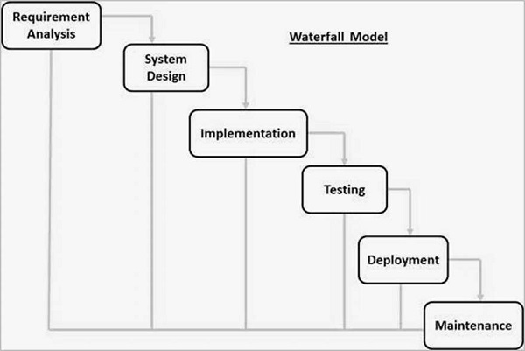

Slide 4
ADVANTAGES OF WATERFALL MODEL

Slide 5
1. The water fall is the simplest and classical model of all the models we have.
2. In this model each and every phase must be completed before moving to the next phase.
3. This model is very suitable also for the small projects where the technical issues are very clear.
4. In this model there is no any case of overlapping. 5. Each phase has a well defined task and a review process

Slide 6
Disadvantages of waterfall model

Slide 7
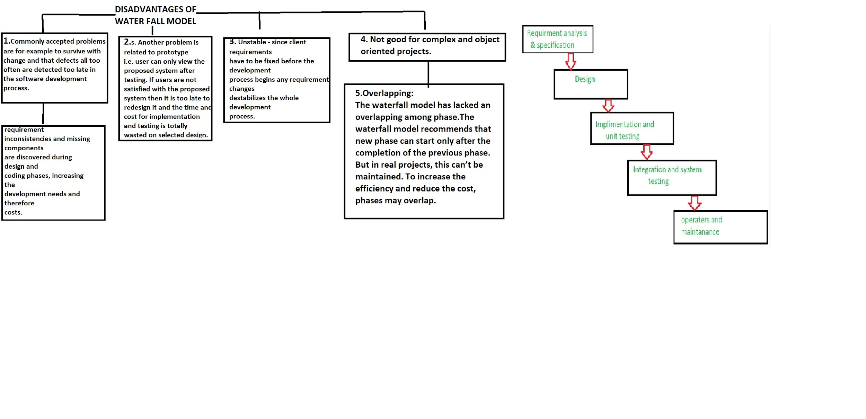

Slide 8
PROJECT IMPLEMENTATION OF WATERFALL MODEL

Slide 9
WATERFALL MODEL IS USED IN -
developing a simple application
for short term projects
whenever we are sure that the requirements will not change

Slide 10
EXAMPLE -
waterfall model can be used in developing a simple calculator.
as the functions of addition, subtraction etc and the numbers will not change for a long time.

